Slide 1
Java FileInputStream class
myfile.txt
Read
Java Application
Peter is going to India
010101011011
010101011011
A FileInputStream obtains input bytes from a file in a file system.
FileInputStream is meant for reading streams of raw bytes such as image data. For reading streams of characters, consider using FileReader.
It should be used to read byte-oriented data for example to read image, audio, video etc.

Slide 2
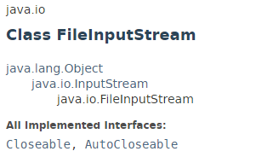
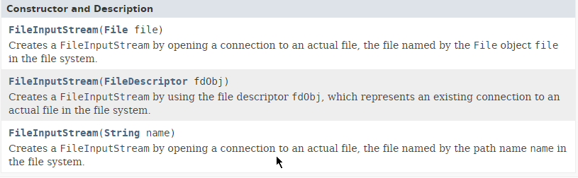
Java FileInputStream class

Slide 3
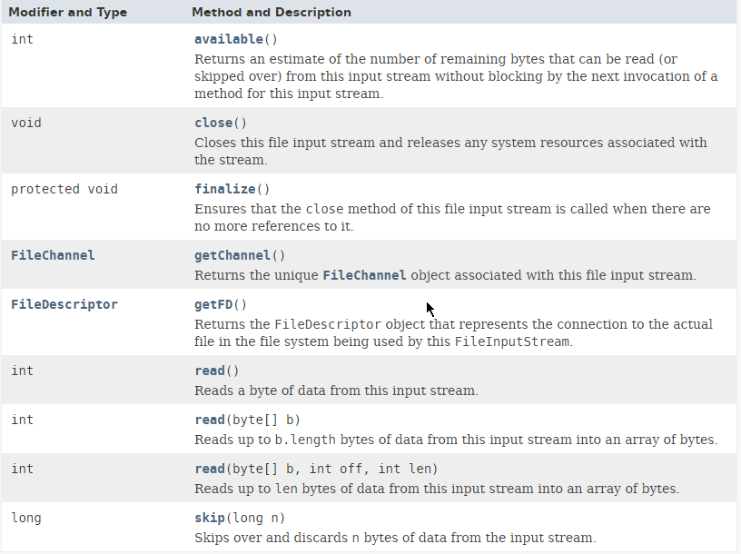
Java FileInputStream class

Slide 4
Java FileInputStream class
https://docs.oracle.com/javase/8/docs/api/index.html?java/io/InputStream.html

